Slide 1

Rockbuster Stealth
Kathryn Robertson
10/20/2023

Slide 2

Motivation
Rockbuster Stealth LLC intends to use its current movie licenses to launch a new online video service to stay competitive with the market

Slide 3

Key Questions
Which movies contributed the least/most to revenue gain?
What was the average rental duration for all videos?
Which countries are Rockbuster customers based in?
Where are customers with a high lifetime value based?
Do sales figures vary between geographic regions?

Slide 4
Data Overview
1,000 Movie Titles
599 Customers
108 Countries

Slide 5


Most and Least Movie Revenue Gain
Most Revenue Gain
1. Telegraph Voyage - $215.75
Least Revenue Gain
958. Oklahoma Jumanji - $5.94
2 | Zorro Ark | 199.72
3 | Wife Turn | 198.73
4 | Innocent Usual | 191.74
5 | Hustler Party | 190.78
957 | Duffel Apocalypse | 5.94
956 | Texas Watch | 5.94
955 | Freedom Cleopatra | 5.95
954 | Rebel Airport | 6.93

Slide 6
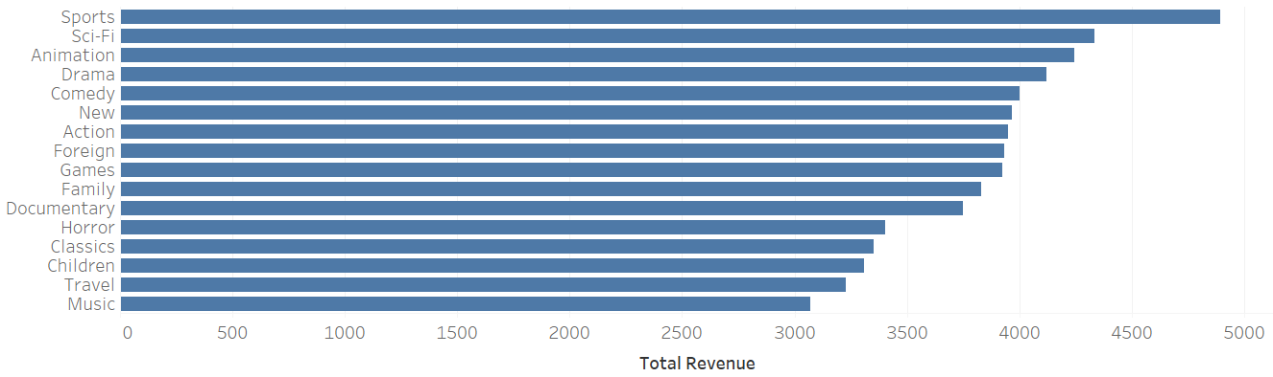
Revenue by Genre
Sports, Sci-Fi, and Animation are the top 3 genres

Slide 7
Rental Duration
Minimum Rental Duration – 3 Days
Maximum Rental Duration – 7 Days
Average Rental Duration – 5 Days

Slide 8
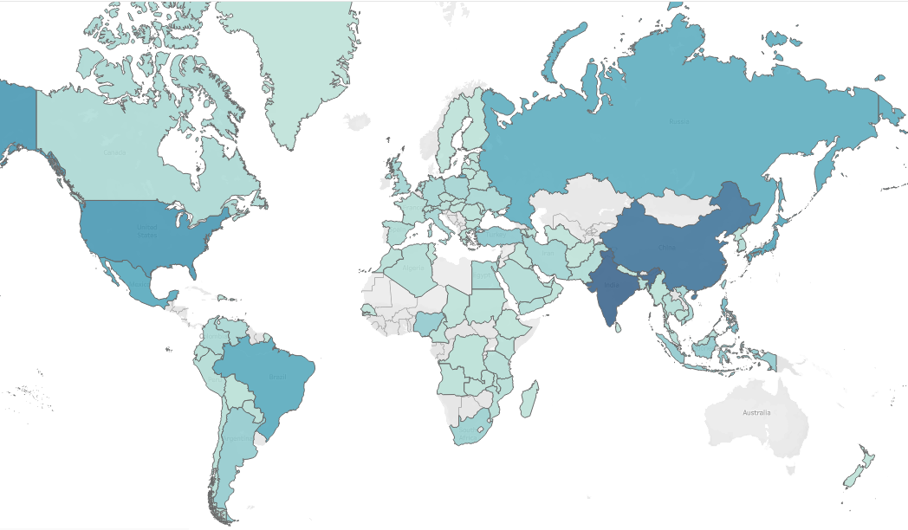
Global Reach

Slide 9
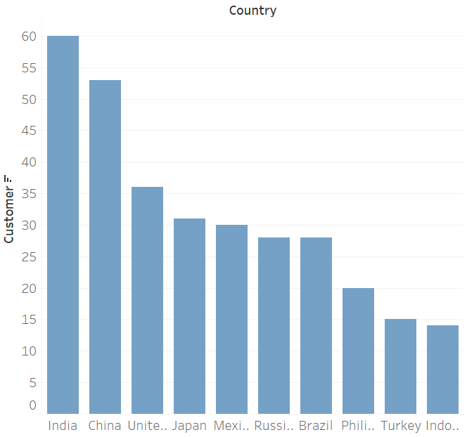
Top Ten Countries By Customers
India has the highest customer count of 60
Indonesia has the lowest customer count of 14

Slide 10
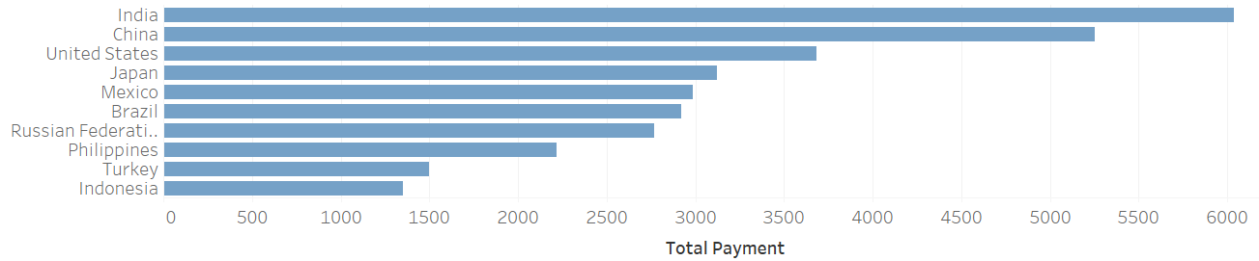
Top Ten Countries By Payment
India has the highest total payments
India, China, and the United States have the top 3 total payments

Slide 11
Top Ten Cities By Customer Count
City | Country | Customer Count
Aurora | United States | 2
Pingxiang | China | 1
Sivas | Turkey | 1
Dhule (Dhulia) | India | 1
Kurashiki | Japan | 1
Xintai | China | 1
Adoni | India | 1
Celaya | Mexico | 1
Nezahualcyotl | Mexico | 1
Atlixco | Mexico | 1
Aurora, United States, is the only city that has a customer count greater than 1

Slide 12
Top Five Customers
Customer ID | First Name | Last Name | City | Country | Total Amount Paid
84 | Sara | Perry | Atlixco | Mexico | 128.70
518 | Gabriel | Harder | Sivas | Turkey | 108.75
587 | Sergio | Stanfield | Celaya | Mexico | 102.76
537 | Clinton | Buford | Aurora | United States | 98.76
367 | Adam | Gooch | Adoni | India | 97.80
Sara Perry is our top paying customer

Slide 13
Countries by Revenue
Highest Revenue
Lowest Revenue
1 | India | $6034.78
2 | China | $5251.03
3 | United States | $3685.31
4 | Japan | $3122.51
5 | Mexico | $2984.83
104 | Afghanistan | $67.82
105 | Tonga | $64.84
106 | Saint Vincent | $64.82
107 | Lithuania | $63.78
108 | American Samoa | $47.85

Slide 14
Recommendations
Prepare to launch the new platform focusing primarily on the top 10 countries.
Increase marketing in the top 10 countries to increase customers. An increase in customers will ensure the new streaming platform will reach a broader reach.
Sports, Sci-Fi, and Animation should be highlighted on the new platform.

Slide 15
Questions?
E-mail: katrobertson75@gmail.com

